Slide 1
Activity Tracking for youth
By Somboon Nontaganok
JSD#4 learner
Generation Thailand

Slide 2
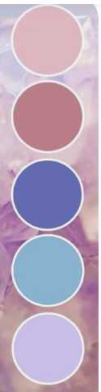
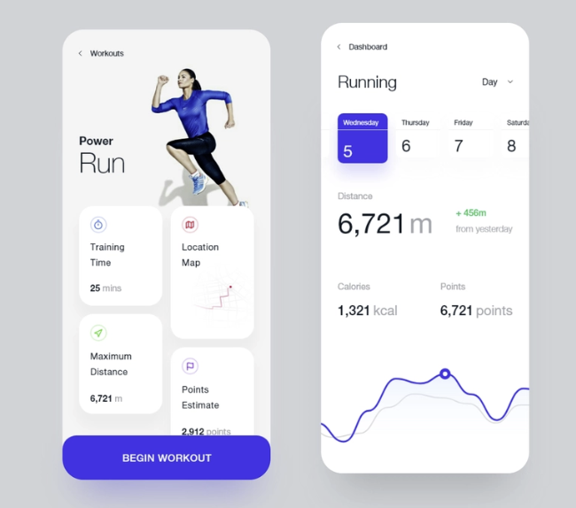
Color palet and run trend.
Picture form pinterest.com

